Slide 1


Instructions for candidates

Slide 2


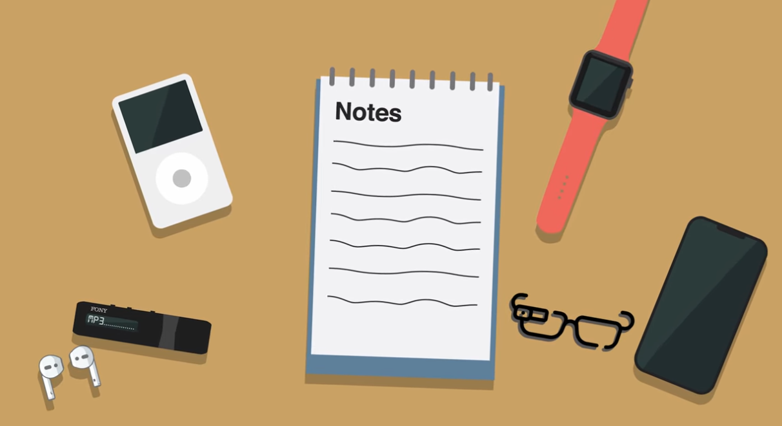
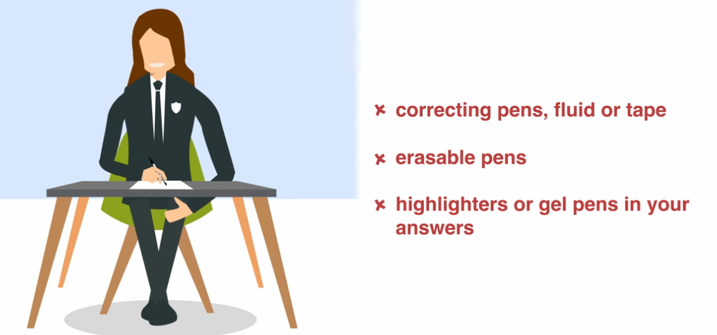
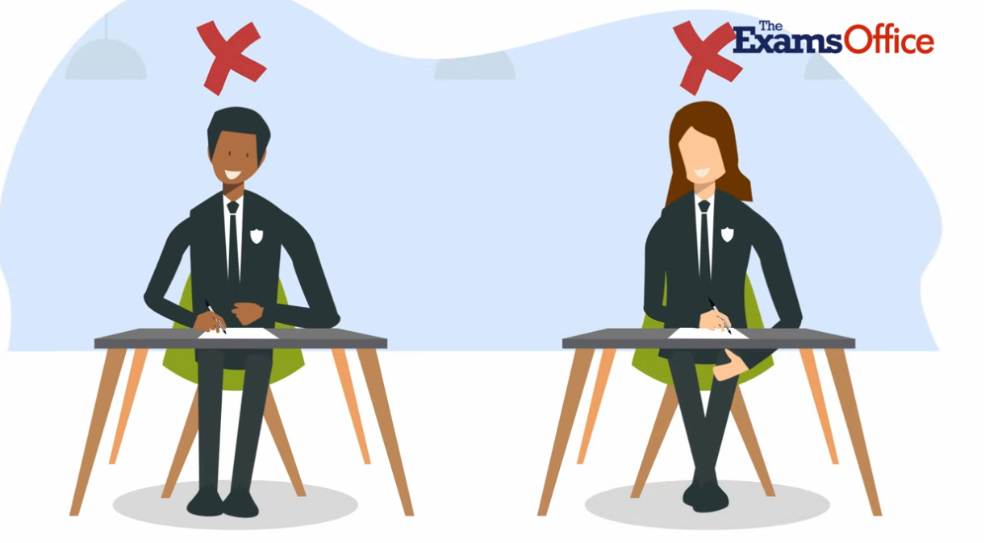
The Rules
Be on time for all your exams- if you are late, your work may not be accepted. If you are VERY late you may not be allowed to sit the exam at all.
Do not become involved in any unfair or dishonest practice during the exam. If you try to break the rules or cheat in any way, you may be disqualified from ALL your exams.
Do not bring any unauthorised items into the exam room (even if you do not intend to use them)
Do not use correcting pens/fluid/tape, erasable pens, highlighters or gel pens in your answers. You may use highlighters to highlight extracts and questions in your question papers or booklets.
Do not talk or try to communicate or disturb other candidates once inside the exam room.

Slide 3
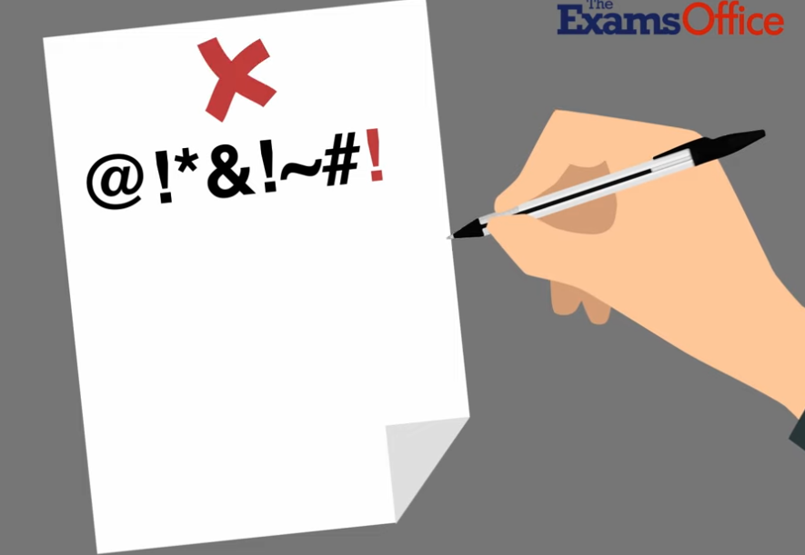
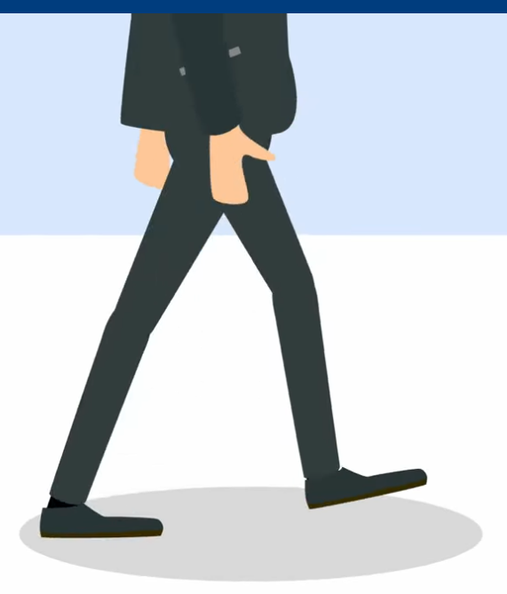
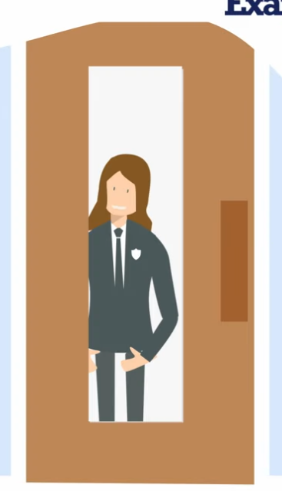


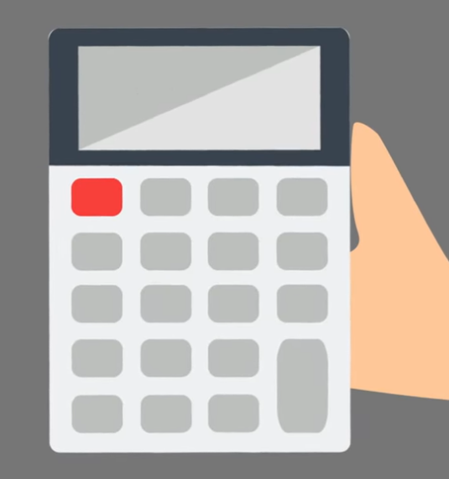

The Rules
You must not write inappropriate, obscene or offensive material
You must not leave the exam room unsupervised before the exam has finished. You will not be allowed back in.
Do not borrow anything from another candidate during the exam
You must write clearly and in black ink. Pencils are to be used for diagrams only.
You may use a calculator unless you are told otherwise. It must be cleared from any stored data and not have any formulae written on the case.
Do not use a dictionary or computer spellchecker unless you are told otherwise.

Slide 4
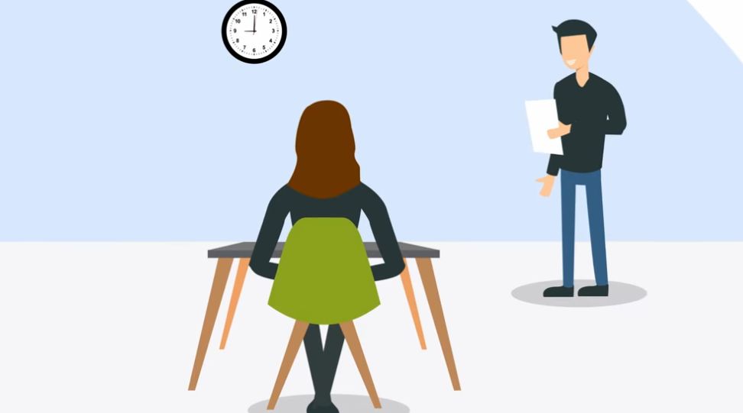

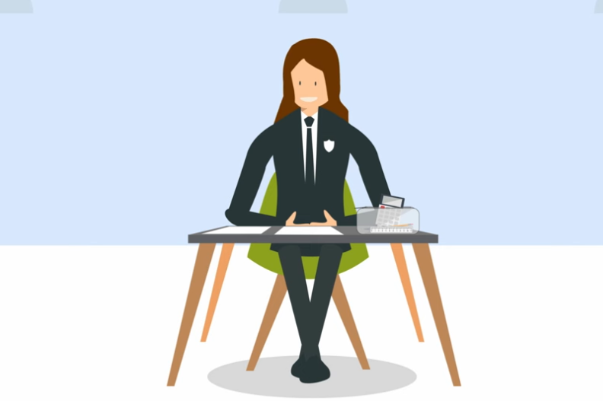
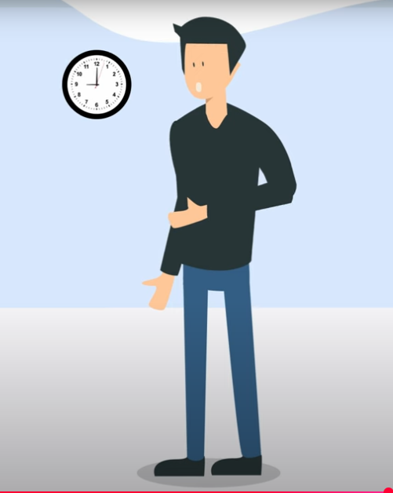

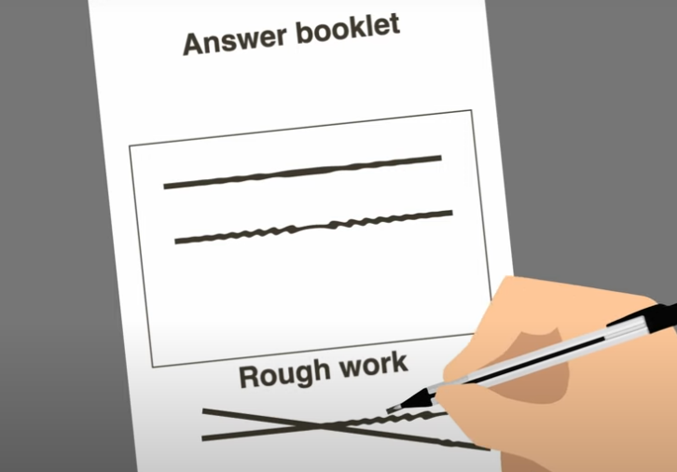
The Rules
Always listen to the invigilator. Always follow their instructions.
Let the invigilator know immediately if:
-you think you have been given the wrong question paper
-you do not have all the materials listed on the front of the paper
-the question paper is incomplete or badly printed
Read carefully and follow the instructions printed on the front of the question paper and the answer booklet
Do not start writing anything until the invigilator tells you to fill in all the details required on the front of the exam paper.
Do not open the question paper until you are told the exam has begun
Remember to write your answers in the designated sections of the booklet. Do any rough work on the proper exam stationery, cross it through and hand it in with your paper.

Slide 5
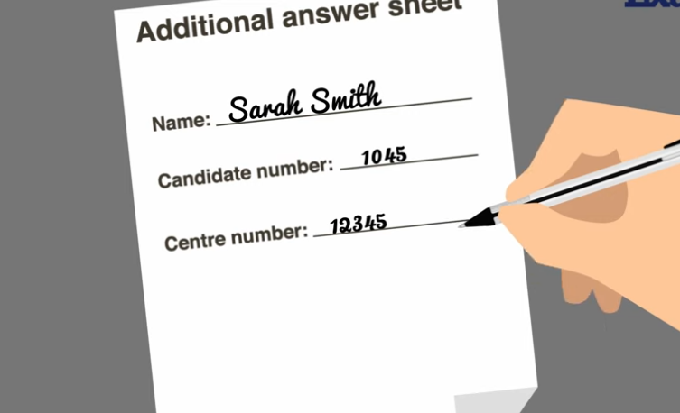
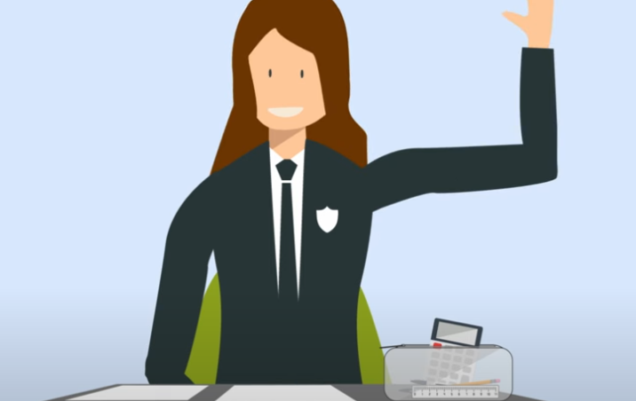

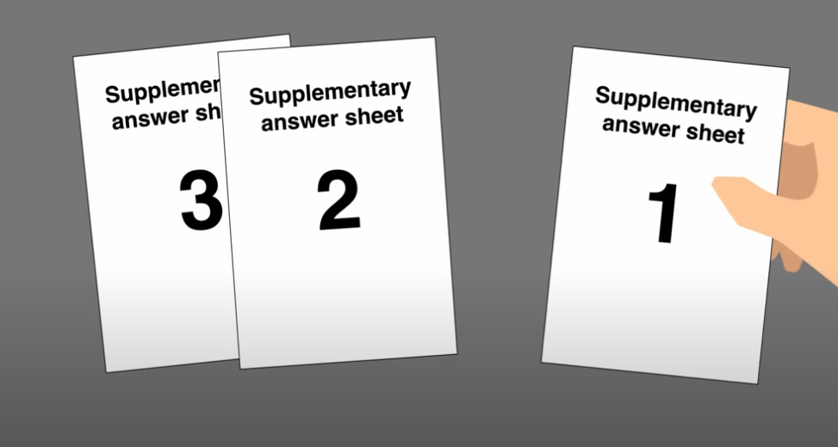
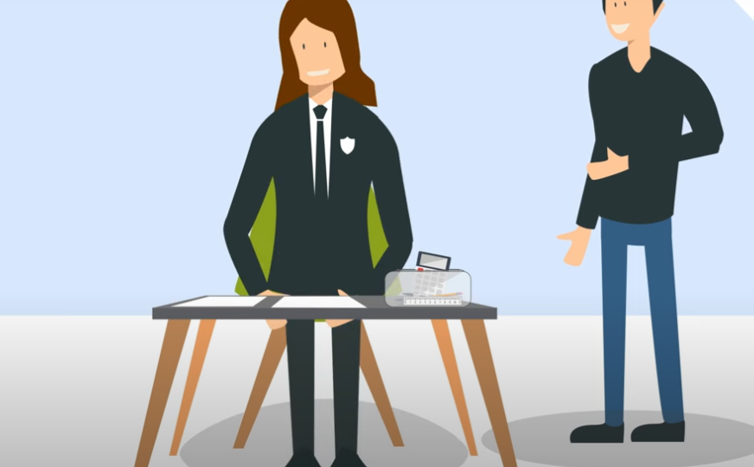
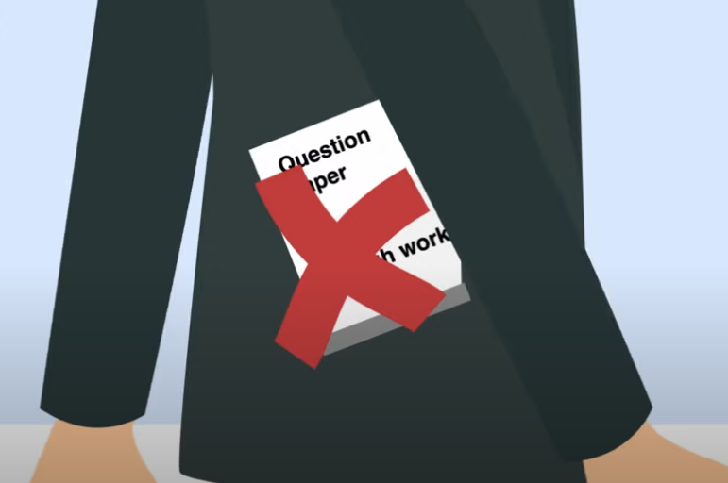
The Rules
Make sure you add your details to any additional answer sheets, including any use for rough work
Put up your hand during the exam if:
-you have a problem and not sure what to do
-you feel unwell
-you need more paper
You must not ask for, and you will not be given any explanation of the questions
At the end of the exam, if you have used any extra answer booklets or sheets, put them in the correct order and place them inside your answer booklet.
Do not leave the exam room unless told to do so by the invigilator
Do not take any stationery from the exam room, including question paper, answer booklet (used or unused), rough work or anything else provided for the exam

Slide 6
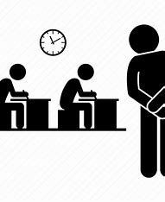
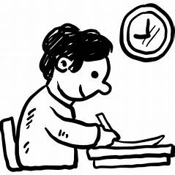
Invigilators
What is an invigilator?
An invigilator is someone who is trained to supervise exams.
Invigilators must follow strict rules and regulations when conducting exams as directed by JCQ and awarding bodies
Listen carefully to the invigilator's instructions. (If you are unsure of anything, please raise your hand and wait for the invigilator to respond)
If you need additional answer sheets, raise your hand and wait for an invigilator to provide you with one. Make sure you add your details to the booklet
If you need to use the toilet or feel unwell, raise your hand and wait for an invigilator to escort you from the exam room

Slide 7
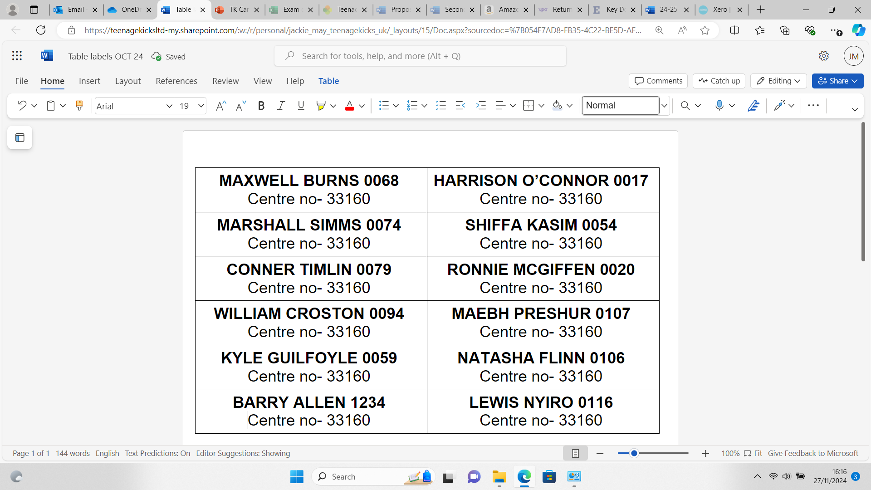
On your exam day
For your exams you will be given a clear pencil case containing:
A black pen
A pencil
An eraser
A ruler
A highlighter
You will also be given (where needed):
A calculator
A protractor and compass
Tracing paper and graph paper
Before sitting your exams, make sure you know:
the date and time of each of your exams. (You will be given an individual timetable)
who to contact at school if there is an emergency that makes you late or unable to sit your exam
When you enter an exam room, you are under exam conditions. If you break any of these conditions, you may be disqualified from your exams
You will have been assigned a seat, which will have your name and candidate number on it to help you fill in the front of your paper.
You MUST write your name in BLOCK CAPITALS when instructed to do so by the invigilator

Slide 8
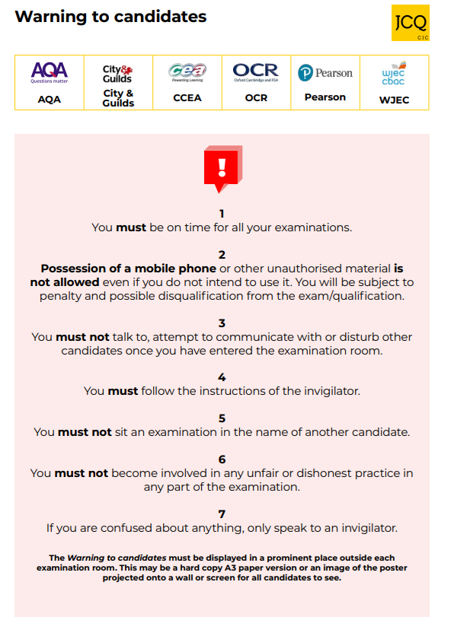

These posters will be outside each exam room
Failure to follow these rules could result in disqualification from your exams

Slide 9

Exam times
Morning exams
will start at
9:00am
Be on time for all your exams, if you are late, your work may not be accepted
Afternoon exams
will start at
1:30pm
If you are over an hour late for your exam you may not be allowed to sit it

Slide 10

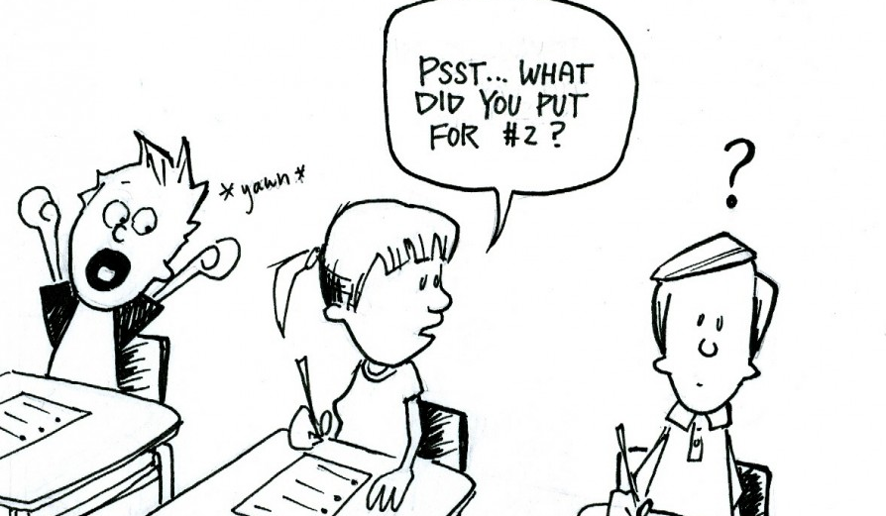
Don't be caught out by scammers selling fake exam papers!
Social media
DO
Have fun
Be responsible
Report any exam or assessment content you see to your teacher
While we like to share our experiences online, when it comes to exams and other assessments, we have to be careful.
Sharing ideas online can be helpful when you are studying or revising
However, sharing certain information can break the rules and could affect your results
If you are not sure what you can and can't discuss online, check with your teacher
If you receive exam content on social media, you must tell your teacher
DO NOT
Buy/ask/share exam or assessment content
Pass on rumours of what's in exams or assessments
Share your work
Work with others so that your assessment is not your own independent work
If you do any of the above, you may:
Receive a written warning
Lose marks
Be disqualified from a part of or all of you qualifications
Be banned from taking exams and assessments for a number of years

Slide 11

Questions...
If you have any more questions about your exams, please ask your teacher or your exams officer
What happens if I am sick or have an injury that will affect me taking the exam?
Contact the school as soon as possible. Depending on the type of sickness or injury, you may still be expected to sit your exam.
What happens if there is really bad weather or travel disruption?
You are expected to plan ahead and make sure you allow plenty of time to get to your exam.
What happens if I forget I have my phone in my pocket?
The invigilator will take it from you but even if you did not plan on using it, you could be disqualified from your exam.
What happens if I forget to set an alarm and get up late?
If you are late for your exam you may still be allowed to sit it but it may not be accepted by the awarding body.
Can I leave the exam early if I have finished?
You must stay in the exam room for a minimum of 1 hour. If you leave the exam room without permission, you will not be allowed back in and may be disqualified from your exam.
What if the school burns down?
We have another site where you can sit your exams, don't worry!
What happens if there is a national emergency?
There are two contingency dates that are set by the JCQ (Joint Council for Qualifications). These dates will be given to centres at the beginning of each year and all candidates are expected to be available.

Slide 12

DO's and DON'T's in
Written Exams
DO's and DON'T's in
On-Screen Exams
Do any rough work on the exam stationery (cross it out and hand it in with your exam paper)
Do write your answers in the designated areas on the paper
Listen carefully to instructions
Write your name on the front of the paper in CAPITALS and black ink only
Do not leave the exam room unless directed to by the invigilator
Do not take any papers or equipment with you when you leave
Do not start writing until the invigilator tells you to
Do not open the question paper until the invigilator says so
Do any rough work on the exam stationery (cross it out and hand it in with your exam paper)
Do write your answers in the designated areas on the paper
Listen carefully to instructions
Write your name on the front of the paper in CAPITALS and black ink only
Do not leave the exam room unless directed to by the invigilator
Do not take any papers or equipment with you when you leave
Do not start writing until the invigilator tells you to
Do not open the question paper until the invigilator says so

Slide 13
DO's and DON'T's in
Non-Exam assessments and coursework
Plagiarise- taking someone else's work and trying to pass it off as your own
Do meet the deadlines your teacher gives you
Do keep your work safe
Do keep any work online safe with a secure password
Do make sure you know where you are getting your research from and that it is accurate
Do not share your work with anyone, including online
Do not use artificial intelligence of any kind
Do not plagiarise someone else's work
Do not cheat, you will get caught and disqualified
Disqualified- you will not be allowed to sit your exam and/or your work will not be accepted
Contingency- an event that may or may not happen but may cause problems

Slide 14


Results and Post - Results
Results will be issued a few weeks after your exams. Certificates will be delivered into school several months later. You will be notified of the dates and when you can collect your result slips and certificates.
Any uncollected certificates will be kept on file for 1 year and then destroyed.
Try not to worry about your exams.
Just do your best and good luck!
If you think your results are not what you expected, there will be an opportunity to apply for re-marking and appeals. Speak to your exams officer for more information.
Appeals must be made within 30 days of receiving your results. (There may be a charge)
For more information, please visit the following link to view the full documents for candidates https://www.jcq.org.uk/exams-office/information-for-candidates-documents/

